Slide 1
Data Curation Project
Group 12
Presenters: Khiem Truong, Geongu Park, Sowmya Nethagani
Notes:
Hello, everyone, welcome to the data curation project presentation of group 12.

Slide 2
What is the Dataset?
311 Service Request received by the City of Chicago.
ex) aircraft noise complaint, tree removal request, sidewalk inspection request, etc
This dataset includes requests created after the launch of the new 311 system on 12/18/2018 and some records from the previous system.
Notes:
The dataset that we have chosen is the 311 service request received by the City of Chicago. The example of records in the data is that aircraft noise complaint, tree removal request, sidewalk inspection request, and etc.
Also, the data includes requests created after the launch of the new 311 system on 12/18/2018 and some records from the previous system.

Slide 3
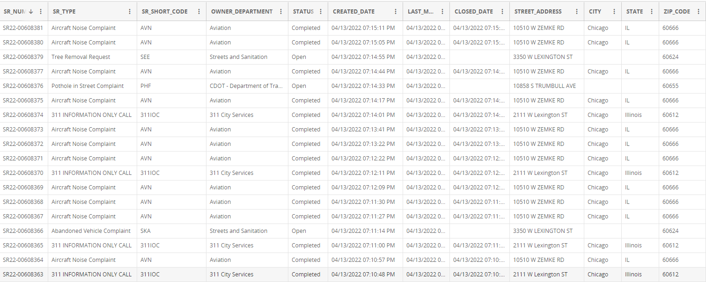
Dataset Overview
Dataset Size: 2GB
58.4M rows, each representing a service request
37 columns
Notes:
The dataset overview. The size of the dataset is 2 gigabytes that contains 58.4 million rows, each representing a service request. Additionally, there are 37 attributes that describe the data.
The attributes examples are created date, closed date, street address, zipcode, and etc.

Slide 4
Data Quality Problems
Multiple columns with no description
e.g: WARD, Electrical district, electricity grid, sanitation division days,…
Multiple columns can be integrated or separated
e.g. Created date, Created Month, Created Hour, Created Day of Week
e.g. Street Address, street number, street direction, street name, street type,
Inconsistent casing and naming schemes
e.g. IL vs Illinois
Notes:
In this slide we are going to discuss about the data quality problem.
There are multiple columns with no description like uncertain columns .
There are also multiple columns that can be integrated or separated like we have given here.
There are some inconsistent casing and naming schemes.
In the following slide we are going to discuss about the solution.

Slide 5
Solutions
Normalize streets’ name
Make sure to have a consistency
ex) Convert mix of IL and Illinois to IL
Fill in the blank if possible
ex) Fill in missing “CITY” and “STATE” using “ZIP_CODE”
Basic sanity check
“Create Date” has to be before “Closed Date”
Ensure if Parent_SR_Number is not empty, Duplicate, and/or Legacy_Record and Legacy_SR_Number are appropriately filled.
Notes:
To solve the problems mentioned in the previous slide, we want to make sure to have a consistency between values in the columns. For example, we will convert mix of IL and illinois to only using IL.
Also we fill in the blanks if we have possible information, such as using zip code to fill in missing city
In the implementation, another dataset with IL’s zip code and city was used to fill in the missing cities name using their zip code
We do the basic sanity check like before closing date first we have to create date
Also we ensured that if Parent_SR_Number is not empty, Duplicate, Legacy_Record and Legacy_SR_Number are filled correctly

Slide 6
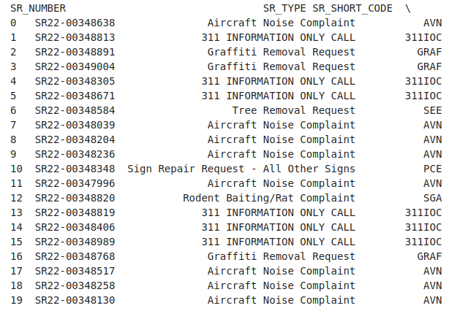
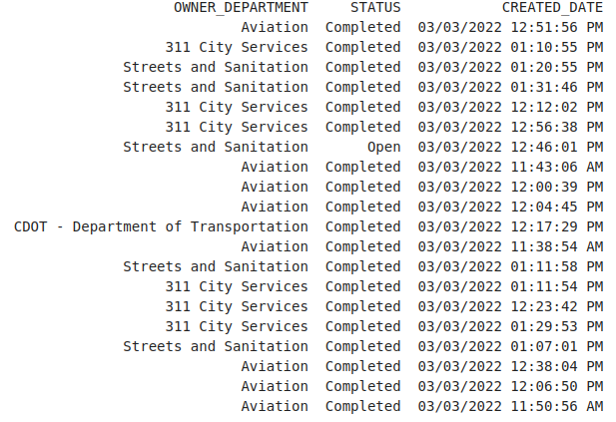

Slide 7
References
Dataset: https://data.cityofchicago.org/Service-Requests/311-Service-Requests/v6vf-nfxy
IL zip code csv: https://worldpopulationreview.com/zips/illinois

